Slide 1
Housing Price Prediction Project
By Sreekari I.

Slide 2
Introduction
Houses are one of the necessary need of each and every person around the globe and therefore housing and real estate market is one of the markets which is one of the major contributors in the world’s economy. It is a very large market and there are various companies working in the domain. Data science comes as a very important tool to solve problems in the domain to help the companies increase their overall revenue, profits, improving their marketing strategies and focusing on changing trends in house sales and purchases.
A US-based housing company named Surprise Housing has decided to enter the Australian market. The company is looking at prospective properties to buy houses to enter the market. The company uses data analytics to purchase houses at a price below their actual values and flip them at a higher price.

Slide 3
Objective
We are going to build a model using Machine Learning in order to predict the actual value of the prospective properties and decide whether to invest in them or not. This model will then be used by the management to understand how exactly the prices vary with the variables. They can accordingly manipulate the strategy of the firm and concentrate on areas that will yield high returns. Further, the model will be a good way for the management to understand the pricing dynamics of a new market.
Data Source
Data is the a crucial element in data analysis and machine learning. In this project, we are using the data collected by the company. The data set consists of the details of sale of houses in Australia.

Slide 4
Data Analysis
The basic steps involved in the data analysis are :
Cleaning, Formatting and Model creation
Cleaning:
It is the first module called to clean the item and verify that all the information in it correspond to the pattern used to extract it. The cleaning module removes the noise, and check that all the values are not empty, otherwise the item is dropped. This is done for simplicity, indeed, it could be better to try to inference them later. After the cleaning part done, the item is sent to the formatting module.
Formatting:
The second module is used to format the item’s values as we want. A basic example could be for the price, initially got being string type, is converted as float. This is done for every numeric values.

Slide 5
Model creation:
Once the data is cleaned and formatted, the predictive model can be created. After this, the model is saved and used for prediction.
Let us work these steps on the given data for analysis.

Slide 6
Data Cleaning
Upon checking the data, I have found some missing values. I have removed those missing values by filling them with appropriate values accordingly.
After handling missing values, I have checked for outliers.
Let us analyse these outliers and remove them.

Slide 7
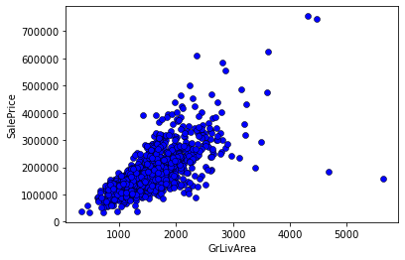
Outliers
We can see that there are few outliers. Now, we will remove them from our dataset. We can do so by keeping data points that have GrLivArea less than 4,000. But first we take a look at the dataset rows that correspond to these unusual values

Slide 8
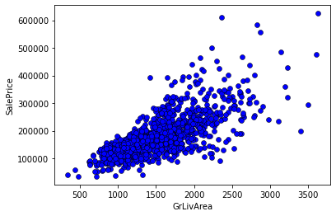
Removing Outliers
To avoid problems in modelling later, we will reset our dataset index after removing the outlier rows, so no gaps remain in our dataset .
After this, I have removed Id column from the dataset because it does not help in predicting the model

Slide 9
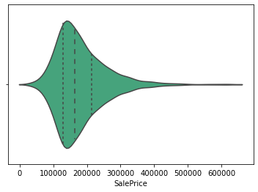
Target Variable(SalePrice) Distribution:
We can see from the plot that most house prices fall between 100,000 and 250,000. The dashed lines represent the locations of the three quartiles Q1, Q2 (the median), and Q3.

Slide 10
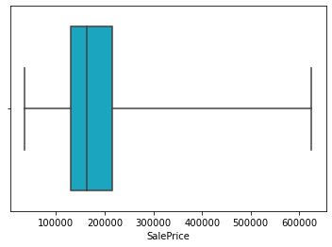
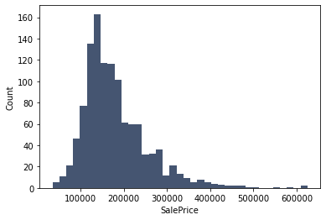
This shows us the minimum and maximum values of SalePrice. It shows us also the three quartiles represented by the box and the vertical line inside of it.

Slide 11
Correlation
We want to see how the dataset variables are correlated with each other and how predictor variables are correlated with the target variable. For example, we would like to see how Lot Area and SalePrice are correlated: Do they increase and decrease together (positive correlation)? Does one of them increase when the other decrease or vice versa (negative correlation)? Or are they not correlated?
Correlation is represented as a value between -1 and +1 where +1 denotes the highest positive correlation, -1 denotes the highest negative correlation, and 0 denotes that there is no correlation.
We will show correlation between our dataset variables (numerical and boolean variables only) using a heatmap graph:

Slide 12
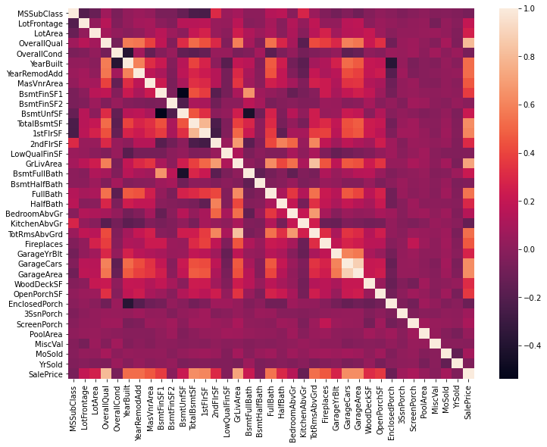

Slide 13
Observations
We notice that GarageCars and GarageArea have high positive correlation which is reasonable because when the garage area increases, its car capacity increases too.
We see also that GrLivArea and TotRms AbvGrd are highly positively correlated which also makes sense because when living area above ground increases, it is expected for the rooms above ground to increase too.
We can see that BsmtUnfSF is negatively correlated with BsmtFinSF1
We note also that BsmtUnfSF is negatively correlated with BsmtFullBath
We see that the target variable(SalePrice) is highly positively correlated with OverallQual and GrLivArea. We see also that the target variable is positively correlated with YearBuilt, Year Remod/Add, MasVnrArea, TotalBsmtSF, 1stFlrSF, FullBath, GarageCars, and GarageArea.

Slide 14
Data Formatting
Here, we convert the non numerical values in the dataset to numerical values.
For Categorical features, I have used One hot encoding.
For ordinal features, I have replaced the unique values of the columns with numbers.
As we have completes data cleaning and data formatting, lets move to predictive modelling.

Slide 15
Predictive Modelling
For this purpose, I am splitting the data for validation. 70% for training and 30% for testing.
I have checked Mean Absolute error for various models.
This tells us that the average difference between the actual data value and the value predicted by the model.
The lower the MAE for a given model, the more closely the model is able to predict the actual values.

Slide 16
The following are the Mean Absolute error values I have got.
 | Model | Mean Absolute Error
1 | Linear regression Model | 19454.107746670077
2 | Random Forest Model | 27044.84857142857
3 | KNN Model | 53894.05714285714
4 | SVM Model | 34533.86571428571
5 | Naïve Bayes Model | 37224.83714285714
6 | Decision Tree Model | 39591.422857142854

Slide 17
Hyper Parameter Tuning
I have done hyper parameter tuning for few models to increase accuracy of the model.
Now let us check these in detail.
---> Decision Tree Model
Best parameters:
{'criterion': 'mae', 'max_features': 79, 'min_samples_leaf': 7, 'min_samples_split': 5}
Decision Tree MAE after Hyper parameter tuning= 27254.204285714284

Slide 18
---> KNN Model
Best parameters:
{'algorithm': 'ball_tree', 'leaf_size': 1, 'n_neighbors': 9, 'weights': 'distance'}
K-Nearest Neighbors MAE after Hyper parameter tuning = 31979.6794615044
---> Random Forest Model
Random Forest MAE after Hyper parameter tuning = 17517.426319047616
Best parameters:
{'n_estimators': 600, 'min_samples_split': 2, 'min_samples_leaf': 1, 'max_features': 19, 'max_depth': 254, 'criterion': 'mse', 'bootstrap': False}

Slide 19
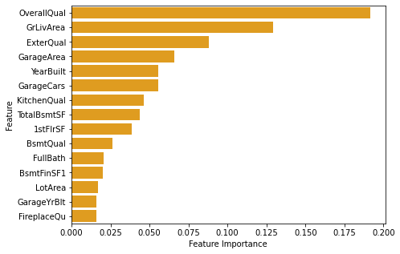
We can see that the mean absolute error (MAE) is less for Random Forest Model when compared to other models.
The above graph shows some of the important features of the Random Forest Model.

Slide 20
Predictions
 | Actual Data | Predicted Data
355 | 256000 | 201305.475000
831 | 319000 | 296902.101667
984 | 195400 | 191507.910000
144 | 274000 | 266208.441667
411 | 131500 | 140648.771667
SAVING THE MODEL
I am saving the model as “housing_price_prediction.pkl” using joblib.

Slide 21
Conclusion
We built several regression models to predict the price of some house given some of the house features. We evaluated and compared each model to determine the one with highest performance. We also looked at how some models rank the features according to their importance.
The model can be used also with datasets that cover different cities and areas provided that they contain the same features. We also suggest that people take into consideration the features that were deemed as most important as seen in the previous section; this might help them estimate the house price better.

